Slide 1
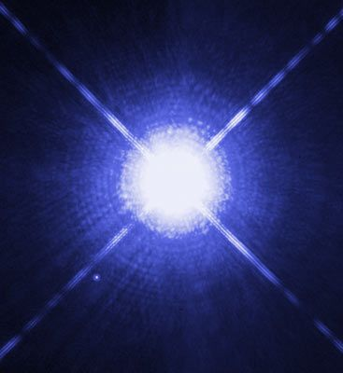
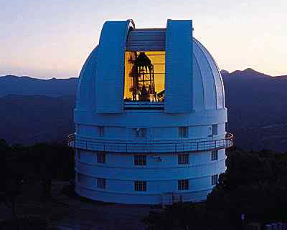
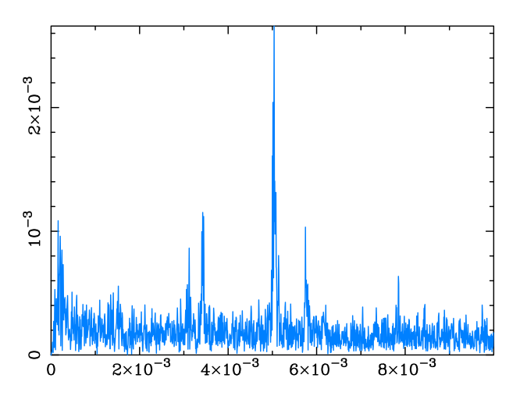
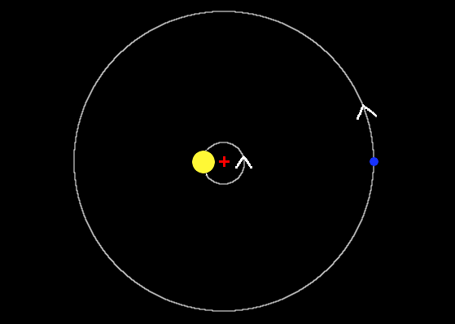
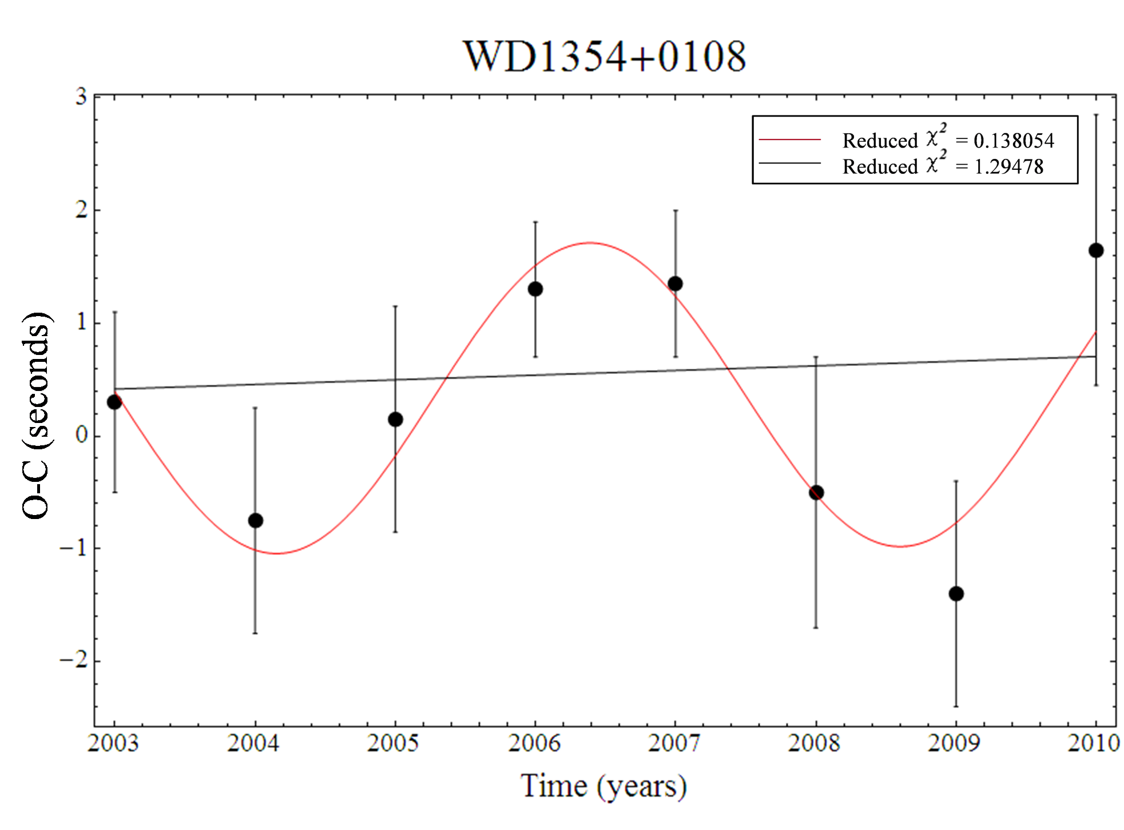
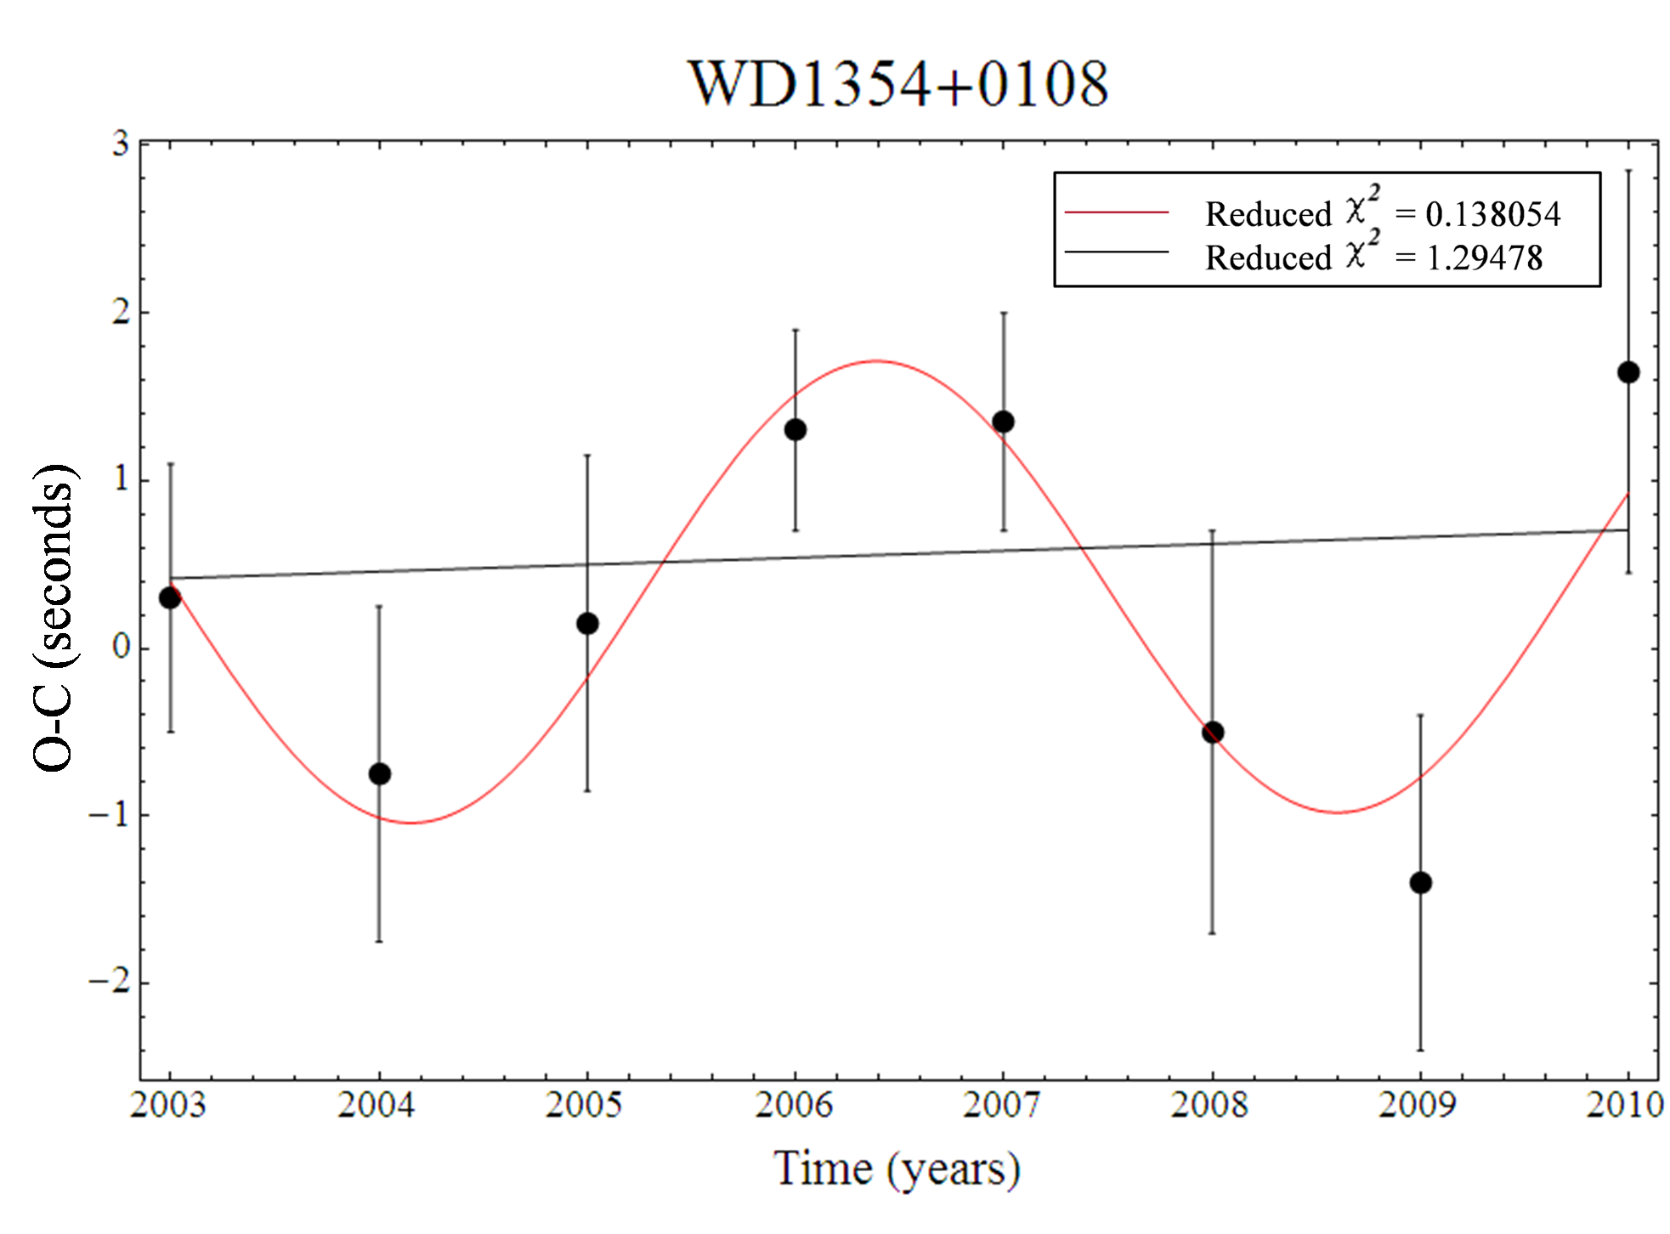
Searching for Planets Around White Dwarfs J. Ellis Department of Astronomy, University of Texas, Austin TX 78712, USA
Divided Lightcurve
Brightness
Time (seconds)
White dwarfs are remnants of stars that have depleted all fusible resources.
~97% of stars end their lives as white dwarfs
White dwarfs within specific, composition dependent, temperature ranges are found to pulsate. These variations in emitted light occur on short time scales with extreme stability.
A mathematical device known as a Fourier Transform (right) picks out the frequencies of the individual pulsation modes
One application is search for extra solar planets.
Stars with planets “wobble” due to the gravitational pull exerted on them by an orbiting planet.
White dwarf moves in space to be closer to and further from Earth with planet’s orbit.
Light travel time results in observed pulses arriving early and late with a sinusoidal variation, corresponding to the orbital period, that can be tracked over time.
Fourier Transform: WD1354+0108
Fractional Intensity
Frequency (Hz)
An O-C (Observed-Calculated) Diagram is a plot of the change in the pulsation arrival times (below).
Reflex motion due to an orbiting planet evidences itself as a sinusoidal signal with a period of one full orbit.
Null result corresponds to a straight line, in which the peaks arrive exactly when they are expected to.
Reflex orbital motion of star, due to an orbiting planet, around a common center of mass.
The O-C diagram for WD1354+0108, for which there is time series data dating back to 2003, shows preliminary evidence of the presence of a planet with an orbital period of about 5 years.

Slide 2
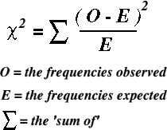
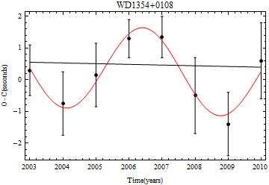
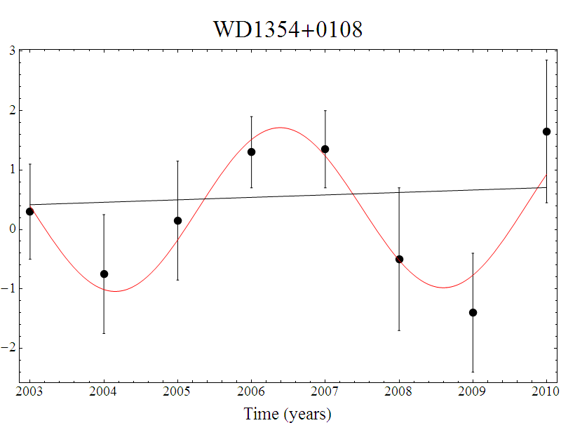
O-C (seconds)
Reduced = 0.138054
Reduced = 1.29478

