Slide 1
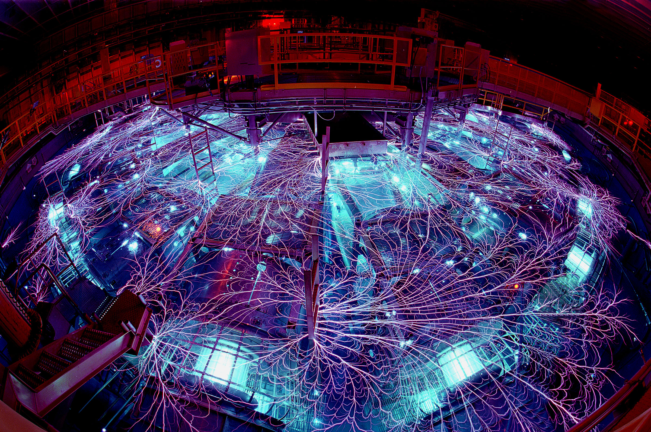
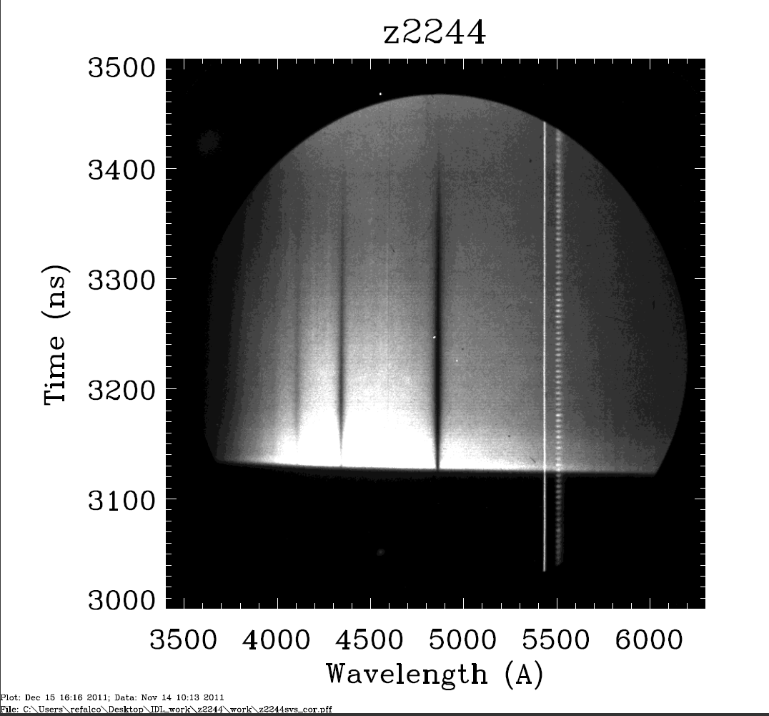
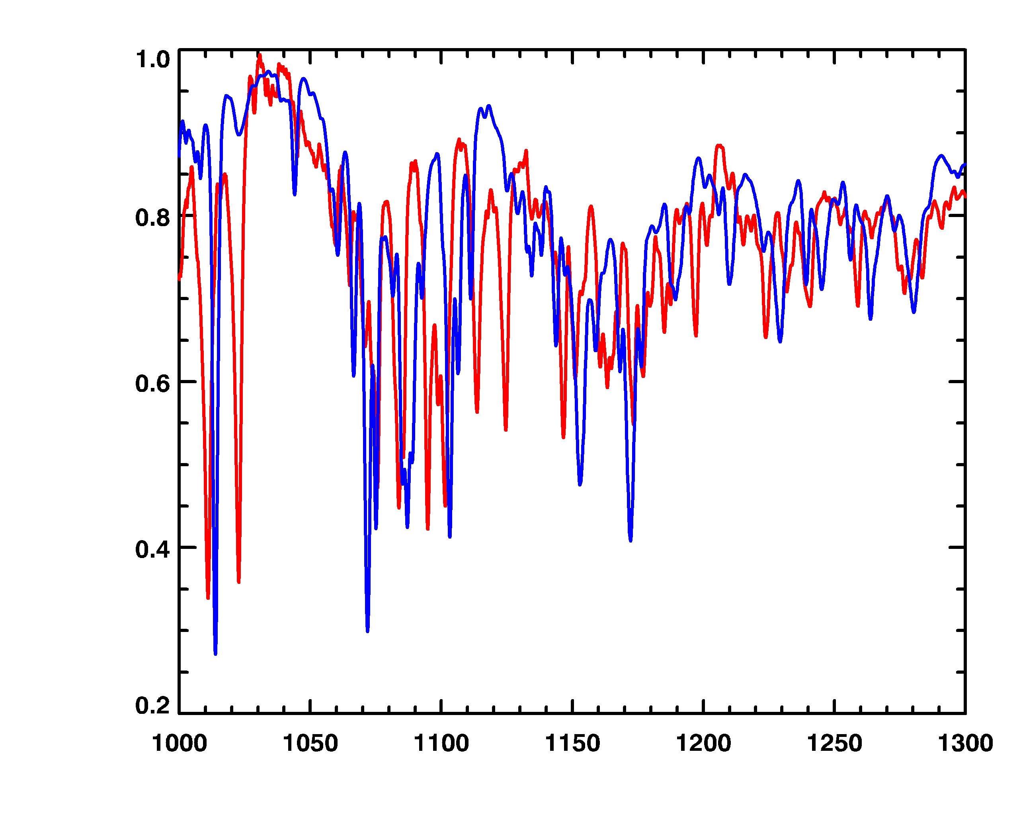
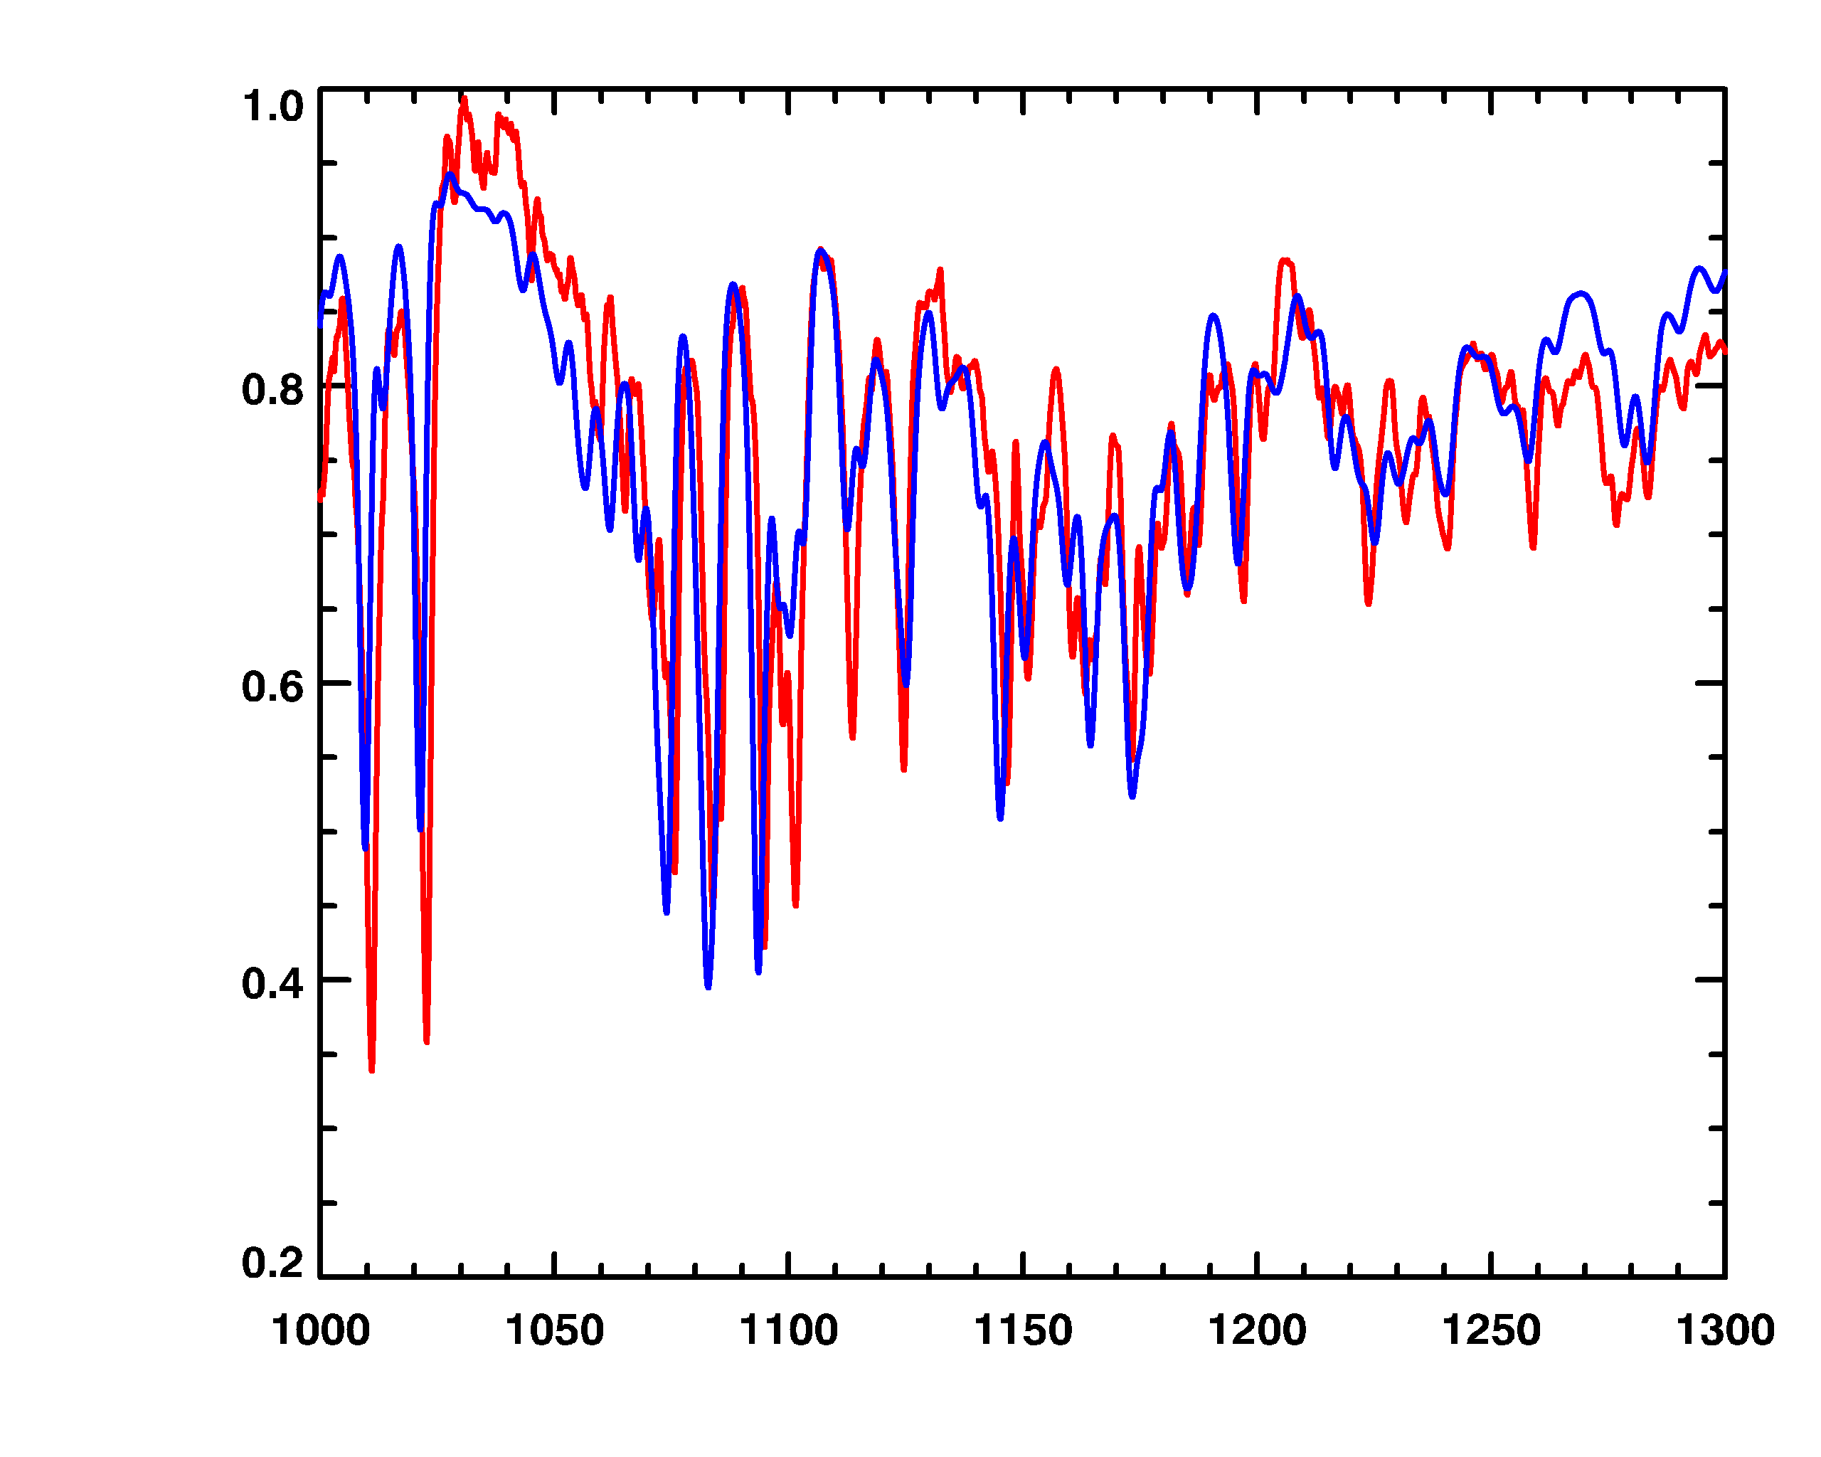
The Z Astrophysical Plasma Properties (ZAPP) Collaboration
Michael H. Montgomery¹, J. E. Bailey², C. Blancard³, A. L. Carlson², D. Cohen⁴, P. Cosse³, G. Dunham², T. Durmaz⁵, J. L. Ellis¹, R. E. Falcon^{1,2}, G. Faussurier³, F. Gilleron³, I. Golovkin⁶, M. R. Gomez², T. A. Gomez¹, I. M. Hall⁵, S. B. Hansen², C. A. Iglesias⁷, M. Kernaghan², P. W. Lake², D. Liedahl⁷, T. Lockard⁵, J. MacArthur⁴, J. J. MacFarlane⁶, R. C. Mancini⁵, S. N. Nahar⁸, T. J. Nash², D. S. Nielsen², J. C. Pain³, M. Pinsonneault⁸, A. K. Pradhan⁸, G. A. Rochau², M. Sherrill⁹, D. E. Winget¹
¹University of Texas at Austin ²Sandia National Laboratories, NM ³CEA, DAM, DIF, F-91297 Arpajon, France ⁴Swarthmore College ⁵University of Nevada, Reno ⁶Prism Computational Sciences ⁷Lawrence Livermore National Laboratory ⁸Ohio State University ⁹Los Alamos National Laboratory
Abstract
Astrophysically-relevant laboratory plasmas with energy densities, volumes, and durations far beyond what was previously possible are being investigated using Z, a z-pinch facility at Sandia National Laboratories that generates electrical power bursts that exceed the entire world’s generating capacity. The Z Astrophysical Plasma Properties (ZAPP) collaboration unites a number of universities and national labs, making use of the unique x-ray source capabilities at the Z facility to simultaneously drive four independent experiments. These experiments create plasmas with a range of conditions (T_{e}=10⁴ - 10⁶ K, n_{e}=10¹⁶ - 10²³ cm⁻³) and are targeted at advancing the knowledge of (1) solar/stellar interior opacities, (2) active galactic nuclei warm-absorber photoionized plasmas, (3) the role of resonant Auger destruction in spectral line emission from accretion powered objects, and (4) spectral line profiles in white dwarf photospheres. These topics are diverse, but they are all heavily influenced by fundamental properties of atoms in plasmas. Our strategy is to reproduce the characteristics of astrophysical conditions as closely as possible in the laboratory and use the measurements to strengthen models for atoms in plasmas. These refined models can then be used more reliably and with greater accuracy in the astrophysics community.
Warm Absorber Photoionization
Motivation: Analysis of x-ray spectra of astrophysical photoionized plasmas from spaced-based observatories such as Chandra and XMM-Newton requires use of complex theoretical models. The accuracy of these models has not been well-explored because of a lack of experimental investigation; experiments have been few because of the difficulty of producing terrestrial photoionized plasmas.
Experiment: Produce a highly photoionized neon plasma (T_{e}~20 - 40 eV) with a simple geometry, known ion number density (~10¹⁸ cm⁻³) and quantified ionizing x-ray flux, and make x-ray (800 - 1800 eV) transmission measurements.
Mancini et al. (2009), Hall et al. (2009, 2010)
Transmission spectrum of photoionized neon plasma with the H, He resonance transitions and the Li-like satellites identified.
The Z Facility
Z is a pulsed power accelerator capable of delivering 26 MA currents to a target load (see Matzen et al. 2005). ZAPP uses the z-pinch dynamic hohlraum configuration (Sanford et al. 2002) where the Lorentz force from the high current implodes a plasma created from a cylindrical wire array, producing ~2 MJ of x-rays.
Resonant Auger Destruction
Motivation: Resonant Auger Destruction is a line-destruction mechanism that has been invoked to explain the apparent absence of Kα emission from L-shell ions in x-ray spectra of accretion-powered black holes. However, observations of neutron star accretors as well as theoretical work dispute aspects of this phenomenon as it is currently described.
Experiment: Produce a photoionized silicon plasma (T_{e}~20 - 40 eV, n_{i}~10¹⁸ cm⁻³), and measure Kα emission and absorption spectra from L-shell ions (6 - 7 Å).
white dwarf photosphere
x-rays from z-pinch
opacity sample
ZAPP performs four independent experiments simultaneously using the same z-pinch x-ray source as the driver.
photoionization samples
White Dwarf Photospheres
Motivation: White dwarf (WD) atmosphere modeling continues to mature (e.g., Tremblay & Bergeron 2009) while relevant laboratory benchmark experiments stagnated decades ago (Wiese et al. 1972). New experiments are needed to address discrepancies between theory and observation (e.g., Koester et al. 2009) and to test the latest theoretical work.
Experiment: Use large x-ray flux to uniformly heat a macroscopic (~38 cm⁻³) hydrogen plasma to WD photospheric conditions (1 - 2 eV, n_{e}~10¹⁷ cm⁻³), and measure optical time-resolved emission/absorption/transmission spectra.
Falcon et al. (2010, poster at this meeting)
H δ
Hγ
Hβ
Solar/Stellar Interior Opacities
Motivation: Solar interior models presently disagree with helioseismology, particularly on the location of the convection zone (CZ) boundary . This is possibly due to inadequate theoretical opacities, which determine stellar spatial temperature and density profiles. Opacity models have never been tested with laboratory experiments at the conditions that exist inside the sun.
Experiment: Reproduce the conditions at the solar CZ boundary (~190 eV, n_{e}=10²³ cm⁻³, charge state) for a uniform sample iron plasma, and make x-ray (800 - 1800 eV) transmission measurements. Bailey et al. (2007, 2009), Mancini et al. (2009)
0.8
0.6
Transmission
Red= Z data
Blue=OP (used for sun)
χ² = 16
0.4
0.8
0.6
Transmission
Red= Z data
Blue=OPAS (“best effort”)
χ² = 3.7
Streaked absorption spectrum of hydrogen plasma produced at Z showing Balmer lines.
0.4
References
0.2
1200
1300
1000
1100
hν (eV)
Opacity Project (Seaton et al. 1994) Rosseland mean is ~1.5x lower than OPAS (Renaudin et al. 2007) at Z conditions (T_{e}~155 eV, n_{e}~7 x 10²¹ cm⁻³).
Bailey et al. 2007, Phys. Rev. Letters, 99, 265002
Bailey et al. 2009, Phys. of Plasmas, 16, 058101
Falcon et al. 2010, AIP Conf. Proc., 1273, 436
Hall et al. 2009, Ap&SS, 322, 117-121
Hall et al. 2010, Rev. of Sci. Inst., 81, 10E324
Koester et al. 2009, J. Phys. Conf. Ser., 172, 012006
Mancini et al. 2009, Phys. of Plasmas, 16, 041001
Matzen et al. 2005, Phys. of Plasmas, 12, 055503
Renaudin et al. 2007, AIP Conf. Proc., 926, 24
Sanford et al. 2002, Phys. of Plasmas, 9, 3573
Seaton et al. 1994, MNRAS, 266, 805
Tremblay & Bergeron 2009, ApJ, 696. 1755
Wiese, Kelleher & Paquette 1972, Phys. Rev. A, 6, 1132

