Slide 1


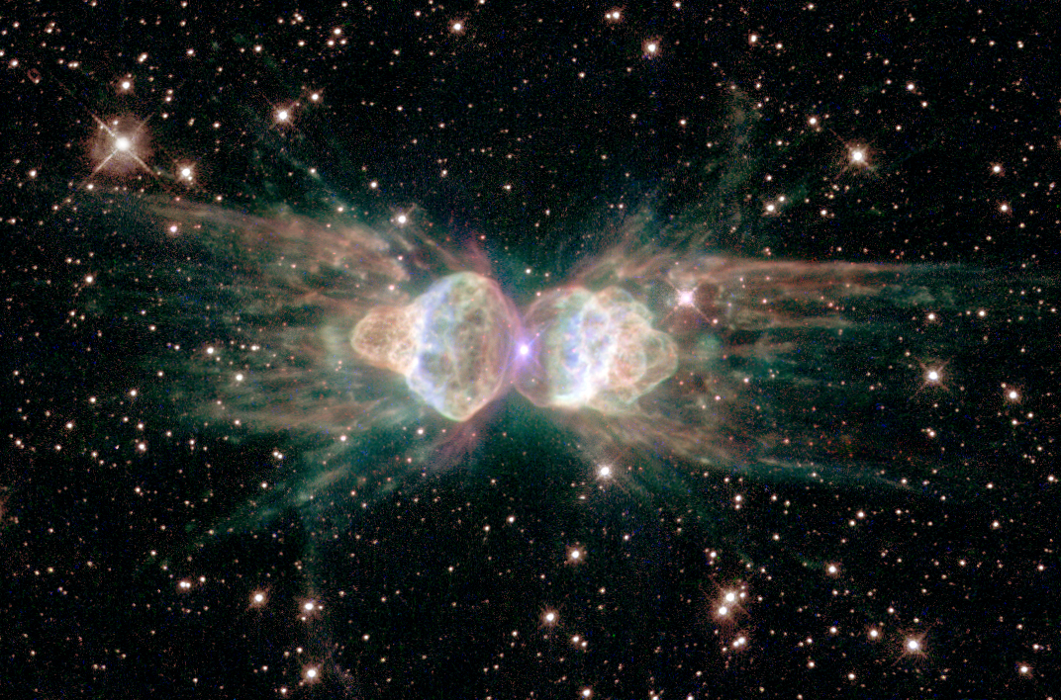

Research Projects for Spring 2013:
Exploring the Physics of the Universe with White Dwarf Stars
Senior personnel: D. E. Winget, M. H. Montgomery
Grad students: Ross Falcon, JJ Hermes, Samuel Harrold, Keaton Bell, Thomas Gomez
Undergrads: Alex, Arina, John, Kevin, Luis, Miquela, Sara, Travis

Slide 2
Information on Summer FRI Fellowships
http://fri.cns.utexas.edu/student-resources/fellowships
Deadline for application is March 25th
List your RE (Mike Montgomery) for your letter of reference
Students in our group usually have half-time awards, which are $1250 for the Summer
You don’t have to have a fellowship to work with us during the Summer, but this is the way to get paid to do it!

Slide 4
How to apply for projects
send an email to mikemon@astro.as.utexas.edu
List your top 3 choices for projects
List times during the week that you are available to work on projects. The more flexible you are, the easier it is us to place you with other students

Slide 5
The UT/McDonald White Dwarf Planet Search
Observations since at least 2003
  Two stars since the 1970s
Monitor pulse arrival times for about a dozen DAVs (hydrogen-atmosphere WDs)
  Similar to the pulsar timing method
> 95% of all stars in our Galaxy (including our Sun) will be DAVs
Pulsation periods 100-500 s
  We expect the period change in these pulsations to be very slow
  (< 1 μs yr⁻¹)
  After 9 years we are sensitive to Jupiter-mass planets from
  2-10 AU
GD 244, typical DAV in our sample
JJ Hermes, UT-Austin, 221st AAS
Mullally et al. 2008, ApJ 676 573

Slide 6
G117-B15A: An Extremely Stable Optical Clock
Some DAVs have been observed for 35+ years, including G117-B15A
The 215.2 s mode in that star produces an extremely stable rate of change of period with time
This dP/dt is in line
with expectations of
cooling for this
~12,000 K WD
The influence of
a Jupiter-mass
planet at 5 AU
would cause an
unmistakable
10 s peak-to-peak
modulation in the
(O-C) diagram
215.2 s mode
JJ Hermes, UT-Austin, 221st AAS
S.O. Kepler 2012, private communication
Notes:
4.19 ± 0.73) × 10−15 s s−1

Slide 7
PG1354+0108: Our Current Best Planet Candidate
The O-C diagram for WD1354+0108, for which there is time series data dating back to 2003, shows preliminary evidence of the presence of a planet with an orbital period of about 5 years. We need a data point for 2013.
The O-C diagram for WD1354+0108, for which there is time series data dating back to 2003, shows preliminary evidence of the presence of a planet with an orbital period of about 5 years.
Notes:
The peak around 0.3 yr would correspond to a 3 MJ planet at 0.4 AU.

Slide 8
On Oct. 24th & 25th, 2011, JJ Hermes at McDonald Observatory found this star:
T_{eff} = 9140 +/- 170 K, log g = 6.16 +/- 0.06, M = 0.17 Msun – the first ELM pulsator!
Period > 4000 sec! Longest known period in a WD pulsator.
We want to find more of these objects!

Slide 9



Modules for Experiments in Stellar Astrophysics

Slide 10
What is MESA?
A description can be found at
http://mesa.sourceforge.net
MESA is an open source software package for doing stellar evolution
Managed by Bill Paxton, with help from Lars Bildsten and the rest of the MESA users community
It is designed to do all stages of stellar evolution using state-of-the-art methods and techniques

Slide 11
What is MESA?
Two papers have come out describing MESA’s capabilities:
  Paper I: Paxton et al. (2011)
    http://adsabs.harvard.edu/abs/2011ApJS..192....3P
  Paper II: Paxton et al. (2013) (submitted)
    http://adsabs.harvard.edu/abs/2013arXiv1301.0319P

Slide 12
What is MESA?
  From Paper I:
  “MESAstar solves the fully coupled structure and composition equations simultaneously. It uses adaptive mesh refinement and sophisticated timestep controls, and supports shared memory parallelism based on OpenMP. State-of-the-art modules provide equation of state, opacity, nuclear reaction rates, element diffusion data, and atmosphere boundary conditions. Each module is constructed as a separate Fortran 95 library with its own explicitly defined public interface to facilitate independent development.”

Slide 13
Why are we interested in MESA?
Can make models prior to WD cooling track
Time-dependent diffusion
Non-grey atmospheres as boundary conditions
Residual nuclear burning
Complete set of possible chemical species
  Can make models of ELM WDs
  Can make models of O/Ne WDs
Can do 1-D hydrodynamics (dynamical velocity fields)
Can treat systems with accretion

Slide 14
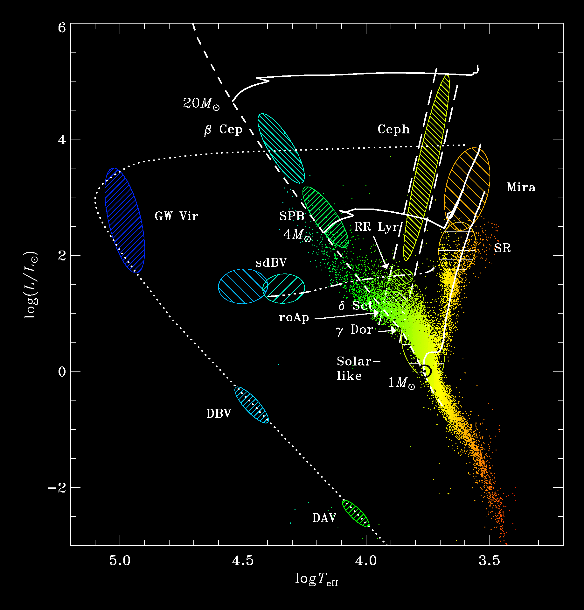
There are pulsating stars *all over* the HR Diagram!
DQV
Notes:
All classes of pulsating white dwarf stars have been discovered by UT astronomers who used the 82-inch telescope.

Slide 15
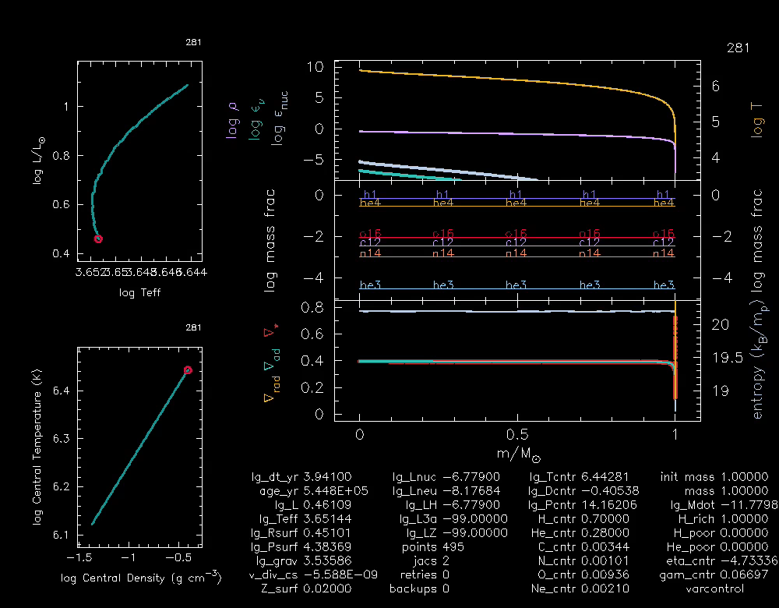
What can you do with MESA?

Slide 18
MESA Projects
All WDs with masses & 1.1 M¯ are believed to have Oxygen/Neon cores instead of Carbon/Oxygen cores. Modern stellar evolution codes have great difficulty getting through the C-burning stage. MESA may be able to do this.
We have recently discovered & 1.2 M¯ WD that pulsates, so these models will be directly relevant to it.

Slide 19
MESA Projects
JJ has discovered all 5 of the extremely low mass (ELM) WDs that pulsate. We would like to make models of these stars to better understand their possible evolutionary histories.
Some WD pulsators are in accreting systems, and we would like to use MESA to study what happens to the pulsations as the WD heats up during an outburst and then cools over the next few years.

Slide 20
Stellar Convection/Nonlinear Light Curves
Convection is one of the largest sources of uncertainty in modeling of stars, yet it is common throughout the H-R diagram:
cores of Main Sequence stars more massive than the Sun
Stellar envelopes of MS stars < 2 M¯
Red giant envelopes

Slide 21
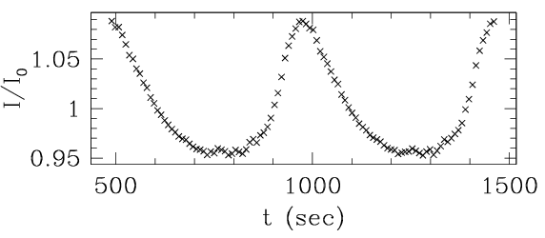
Can we use the lightcurve shape itself to learn about these stars?
Need a mechanism for producing non-linearities
  convection zone is most likely candidate
  can change thickness by » 10 during pulsations

Slide 22
Hybrid Approach
(Montgomery 2005, ApJ, 633, 1142), based on work of Brickhill (1992), Wu & Goldreich (1998), and
Ising & Koester (2001)
) Assumes all the nonlinearity is caused by the convection zone:
nonlinear convection zone (non-sinusoidal)
linear interior
(sinusoidal)

Slide 23
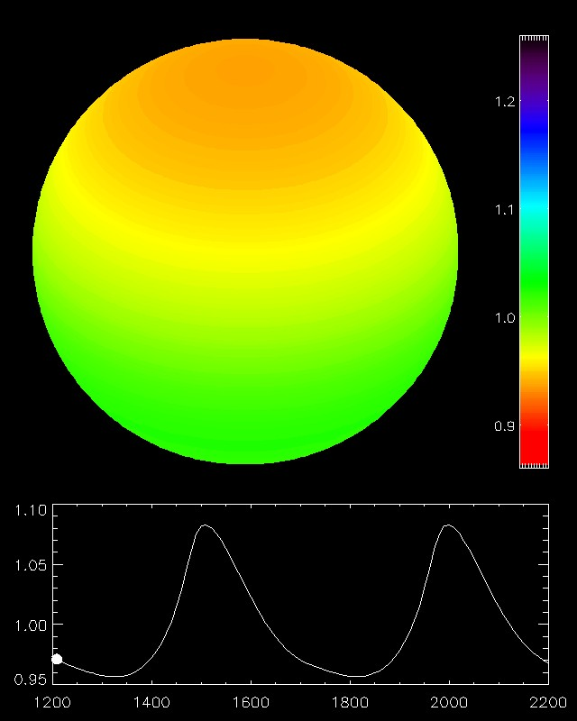
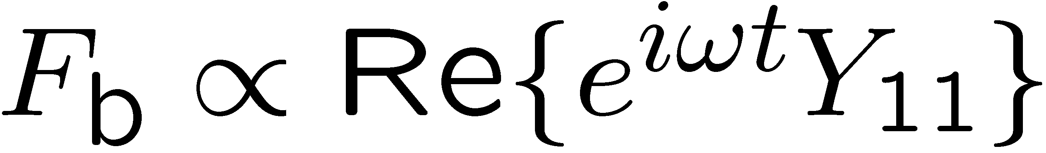
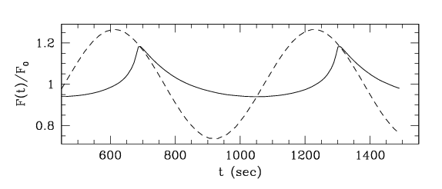
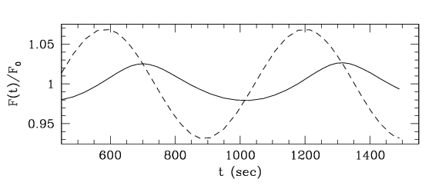
Non-radial Modes
l=1,m=0
(traveling wave)

Slide 24
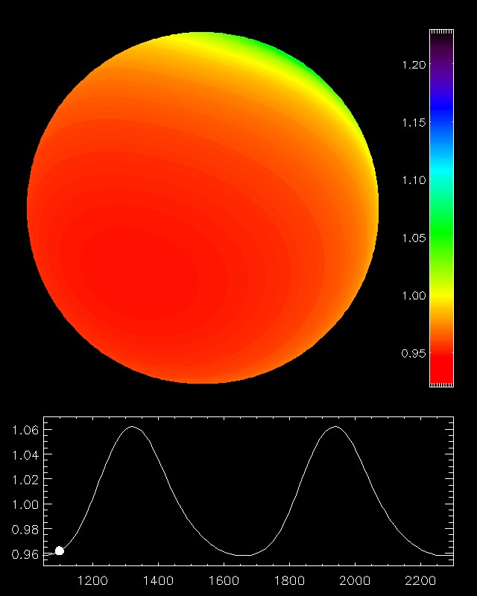
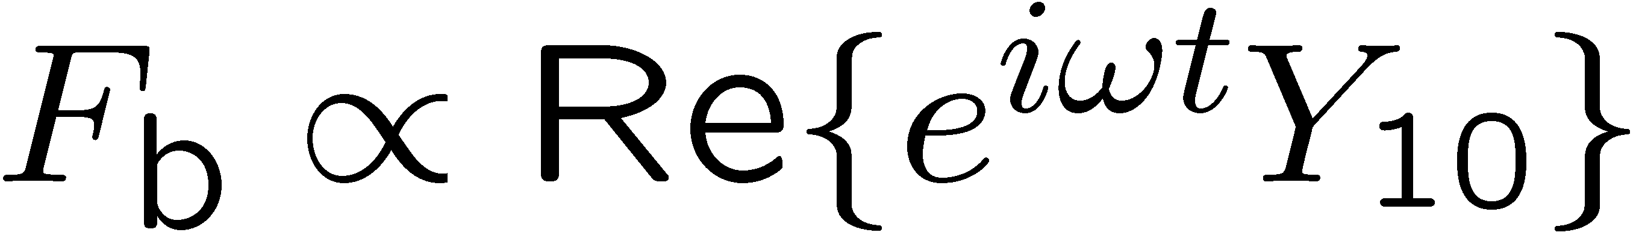
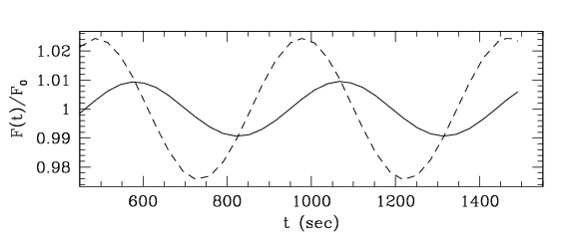
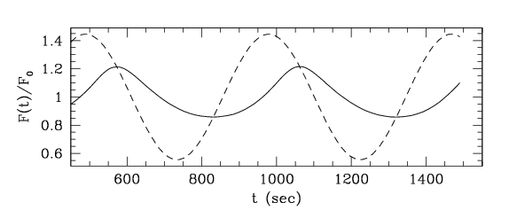
Non-radial Modes
l=1,m=1
(standing wave)

Slide 25
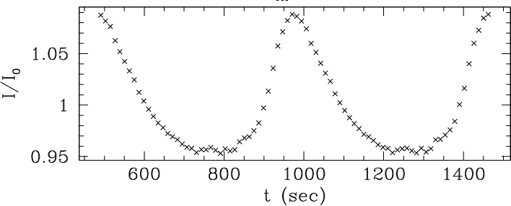
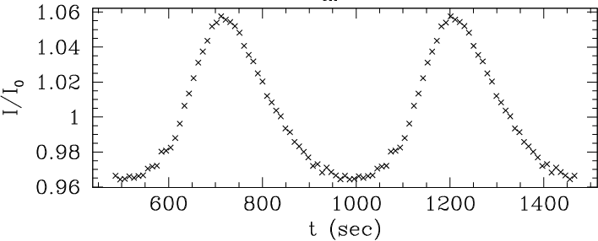
PG 1351+489 (DBV)
Whole Earth Telescope (WET) – 1995
Single site data – May 2004

Slide 26
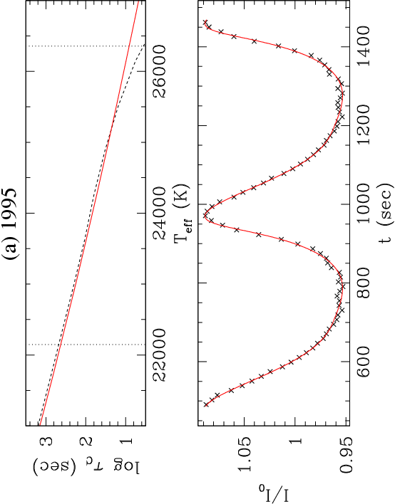
PG 1351+489 (DBV)
Whole Earth Telescope (WET) – 1995
τ_{C}= 86.7 sec
N=22.7
θ_{i}=57.8 deg
l=1,m=0
Amp=0.328
Single site data – May 2004

Slide 27
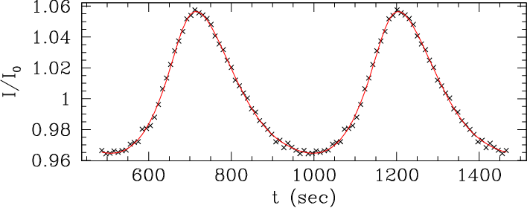
PG 1351+489 (DBV)
Whole Earth Telescope (WET) – 1995
τ_{C}= 86.7 sec
N=22.7
θ_{i}=57.8 deg
l=1,m=0
Amp=0.328
Single site data – May 2004
τ_{C}= 89.9 sec
N=19.2
θ_{i}=58.9 deg
l=1,m=0
Amp=0.257

Slide 29
We can apply these techniques to the stars and data in this sample of objects…which is based on Argos data!

Slide 30
FRI Spring 2013:
Evaluating the ProEM Camera
Mentor: Samuel Harrold

Slide 31
About the new camera

Slide 32
Tasks
Determine whether or not we can detect an object using this camera on a telescope.
  What magnitude?
  What amplitudes?
  What frequencies?
  Similar analysis: http://www.apo.nmsu.edu/arc35m/Instruments/AGILE/#3p3
Can we detect a pulsar from the 82-inch? http://www.youtube.com/watch?v=_grWV6c_3_o

Slide 33
Research with Michel Breger:
Studying Modes of Pulsation in
Delta Scuti Variable Stars

Slide 34
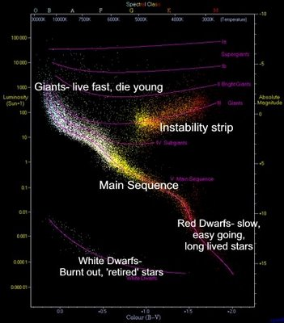
Delta Scuti Variable Stars
What is a Delta Scuti Variable Star?
  Exists where the instability strip and main sequence cross
  Low Amplitude, Short Period (.03 - .3 days)
  About 1.5 – 2.5 Solar Masses

Slide 35
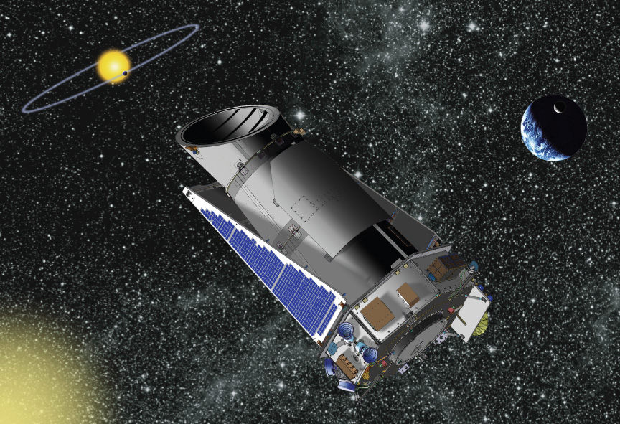
Kepler Spacecraft
Designed to discover Earth-like planets orbiting other stars
We reduce the raw data sent from the Kepler spacecraft to a form workable for asteroseismology
We use Short Cadence data (30 second intervals) and Long Cadence data (30 minute intervals) – Extremely accurate!

Slide 36
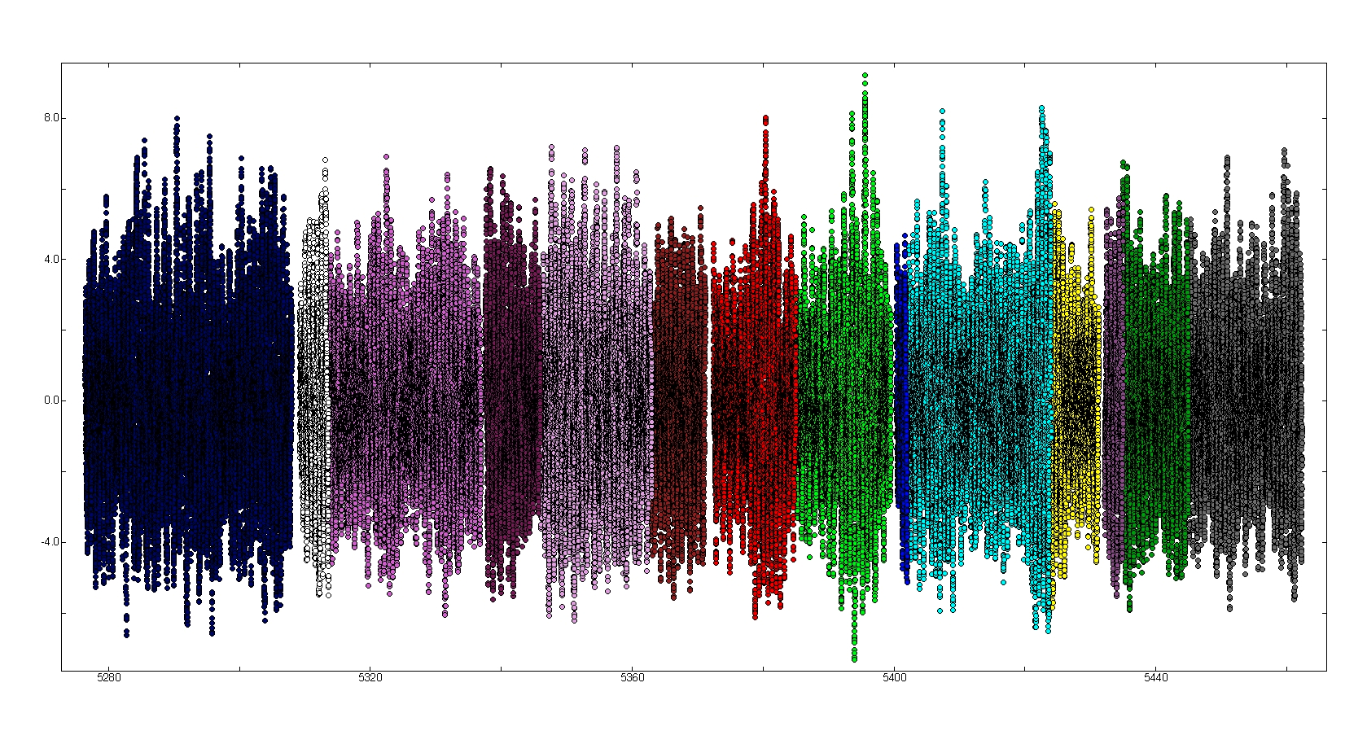
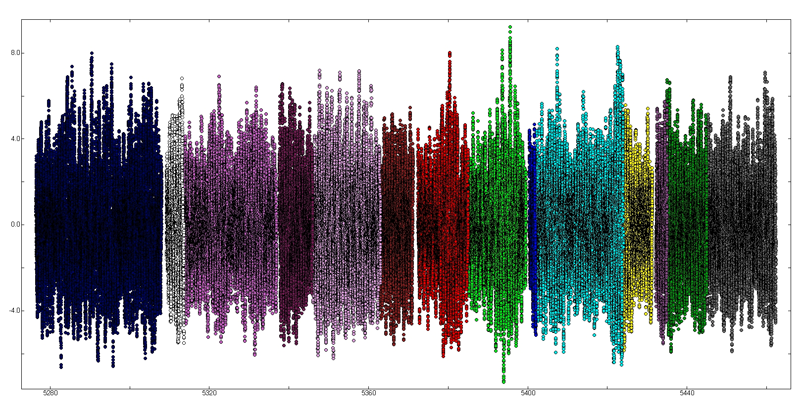
KIC 9664869
Observed
Time (900 days)

Slide 37
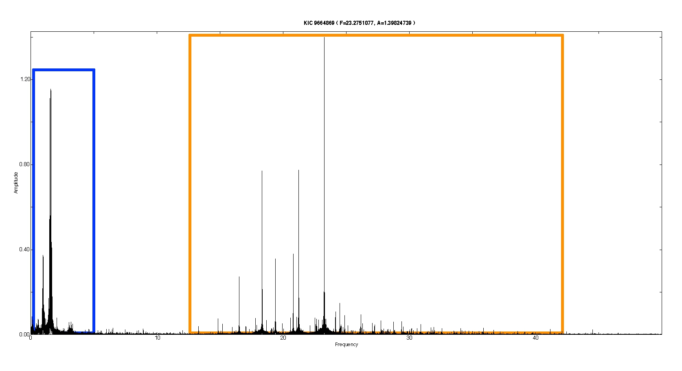
Amplitude
Frequency (cycles/day)

Slide 38
Findings
Three equidistant frequency triplets are found in the star, each with different separations
  Not sure which one results from rotation
We have managed to calculate almost exact frequency compared to the data, but the amplitude is misaligned.
  This is caused by more than two years worth of super-accurate data still being insufficient in length to sample the multitude of excited frequencies of similar values – a resolution error

Slide 39
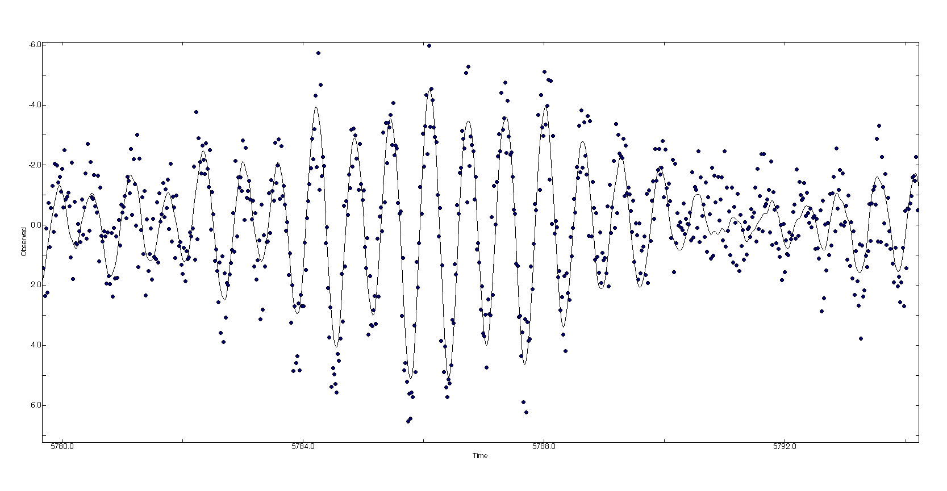
Observed
Time (days)

Slide 40
Further Work
Create a better fit for the light curve as more data is released
Determine whether the gravity modes or pressure modes are the dominant cause of variability
Analyze the triplets in more detail to better understand the star
We have analyzed a little under 400 frequencies, but there are still many more to be detected.

Slide 41
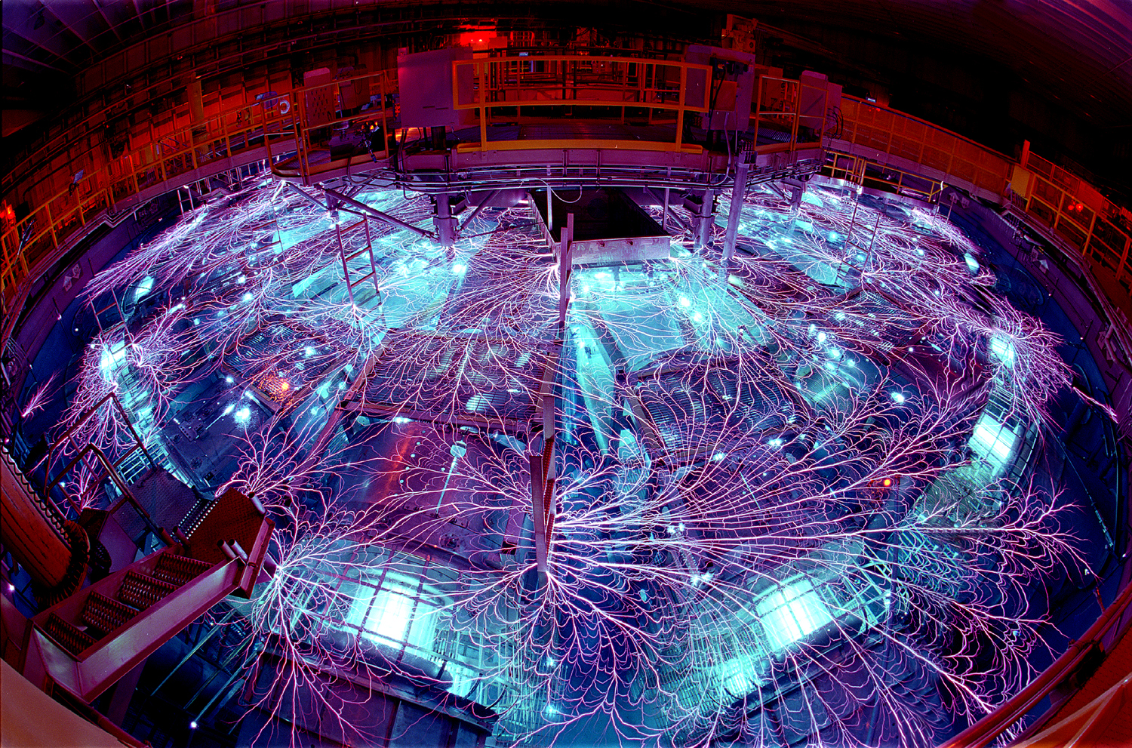
White Dwarf Project at Sandia
Don Winget, Mike Montgomery, Jim Bailey, Greg Rochau, Ross Falcon, Thomas Gomez, Travis Pille, Sean Moorhead

Slide 42
“Typical” WD Spectrum: the Balmer Series
H8
2 , 8
H²
2 , 7
H±
H°
H¯
2 , 6
2 , 5
2 , 4
Notes:
Take one of our highest S/N spectra and mark it “Typical”
Hbeta: 4-2
Hgamma: 5-2
Hdelta: 6-2
Hepsilon: 7-2
H8: 8-2 : aka zeta
H9: 9-2 : aka eta

Slide 43
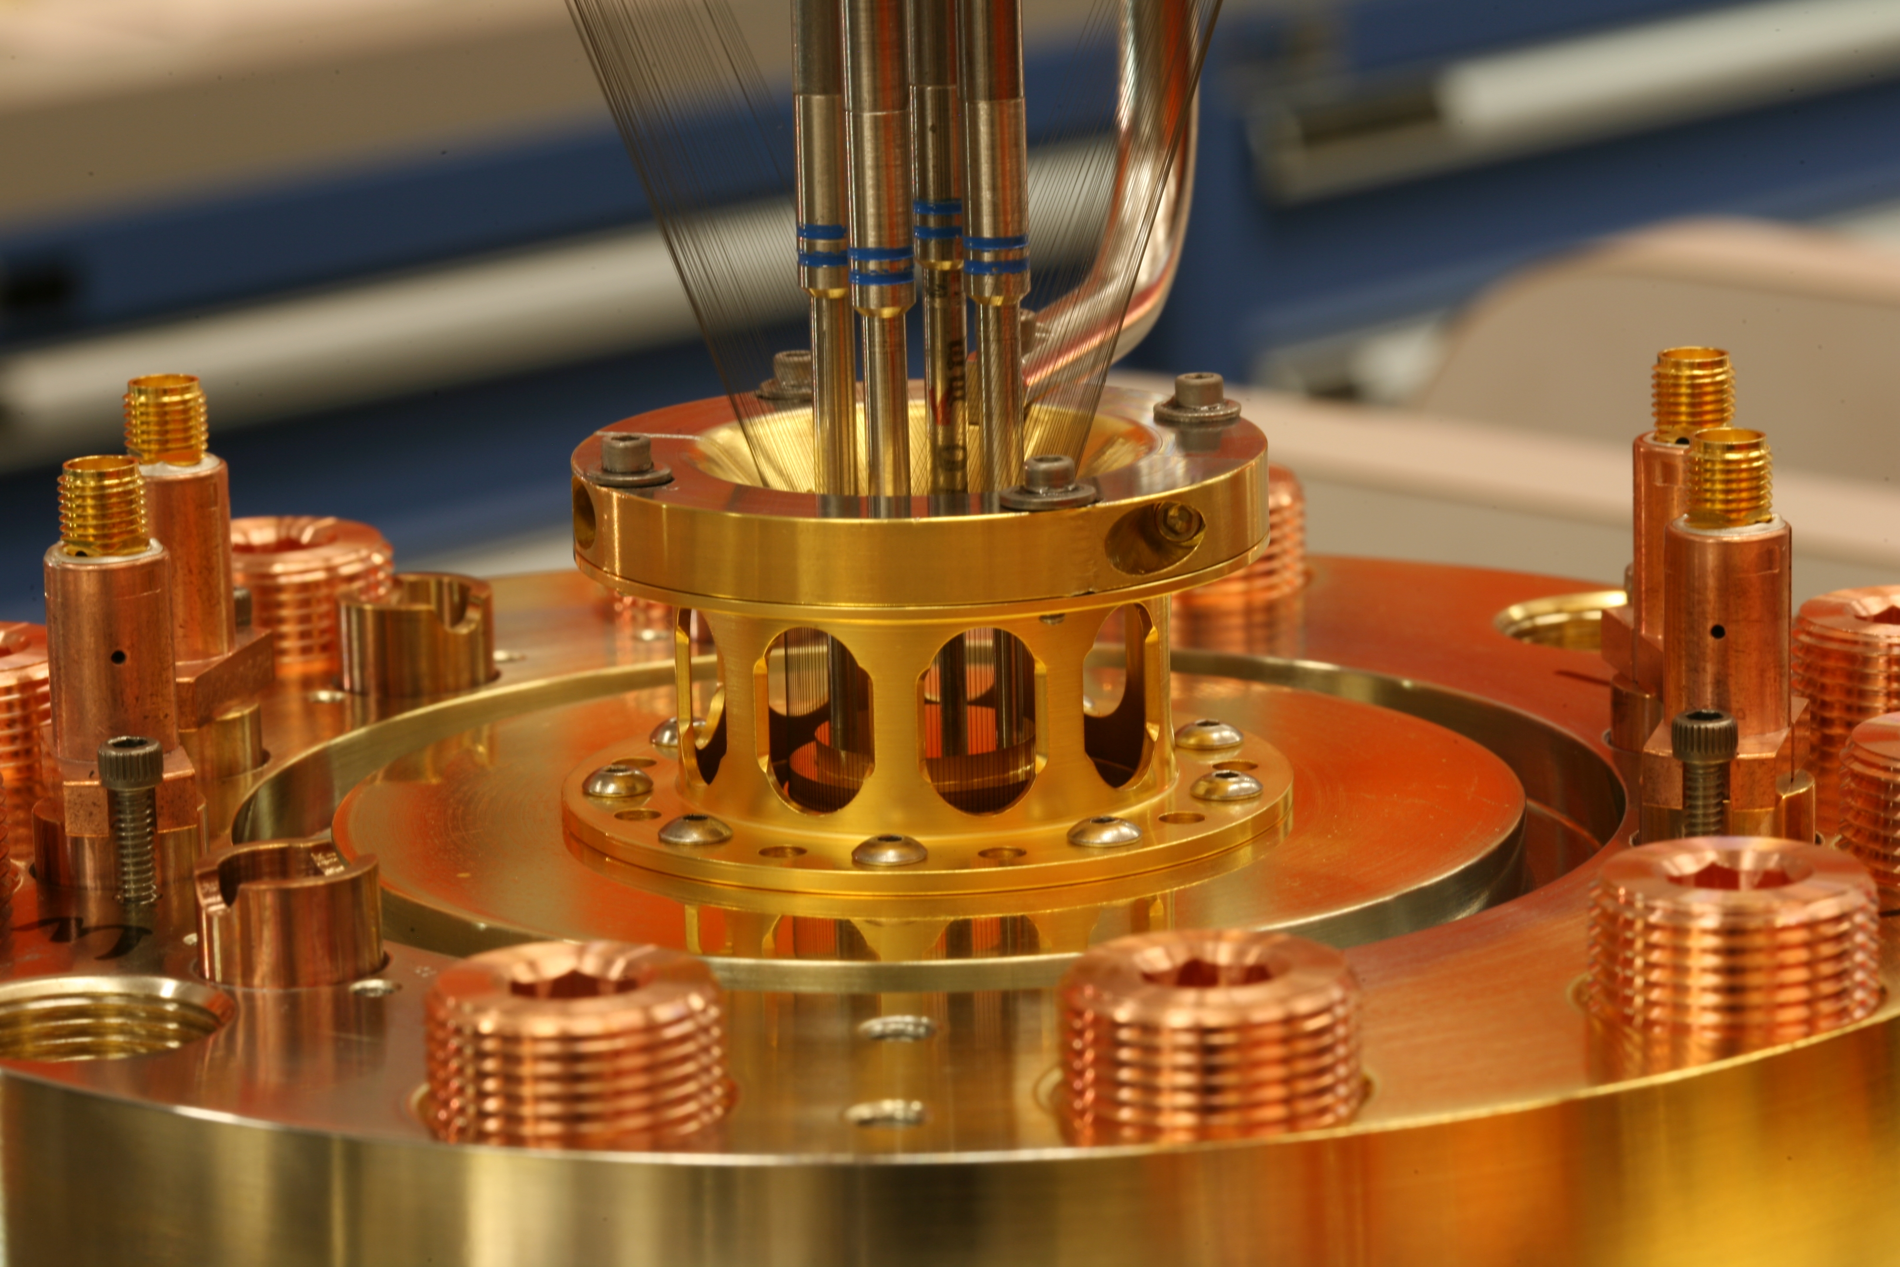
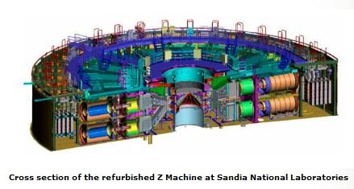
The Z Machine: Pulsed Power
The Z machine is capable of converting 26 million amps into a peak X-ray emission of 350 terawatts, allowing us to create extreme conditions in a laboratory setting
“Z Machine Produces Six Times the World’s Energy to Create White Dwarf Star”
  http://techland.time.com/2012/08/10/z-machine-produces-six-times-the-worlds-energy-to-create-white-dwarf-star/
More information can be found at www.sandia.gov/z-machine/

Slide 44
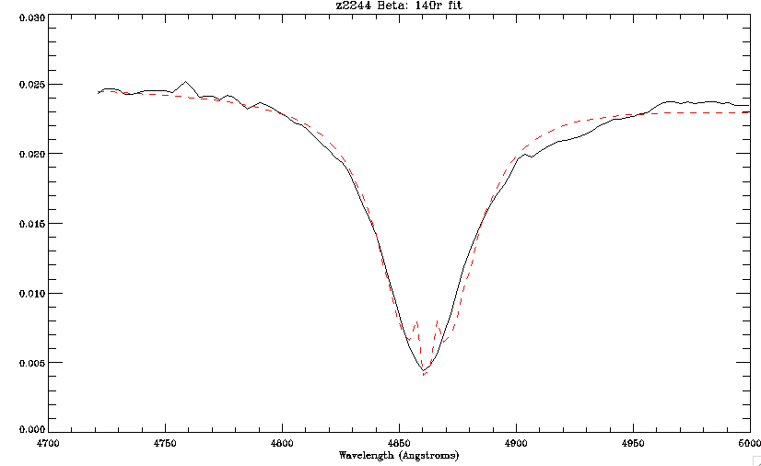
The Experiment
We use these extreme conditions to ionize a confined hydrogen gas, recreating a white dwarf photosphere.
We then are able to observe the time evolution of the gas’ spectrum (Balmer series) using fiber optic cables and a streak camera.
Thanks to Ross Falcon’s ACE configuration, we are now able to measure absorption and emission spectra as well as the background continuum simultaneously!

Slide 45
Why is this important, we can just observe actual white dwarf spectra right?
Ross Falcon, a grad student working with our group, found that the masses of white dwarfs as determined through gravitational redshifting were much larger than those determined spectroscopically. (Ask for paper)
Because of this, we have set out to create our own data set at known conditions in order to test and constrain current spectral line theories.

Slide 46
FRI Spring 2013:
Evaluating the ProEM Camera
Mentor: Samuel Harrold

Slide 47
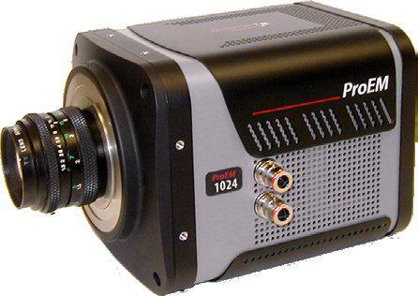
About the new camera
Notes:
Extremely sensitive. Made for very low-light applications.
Very fast frame rates, much faster than we usually use.

Slide 48
Tasks
Determine whether or not we can detect an object using this camera on a telescope.
  What magnitude?
  What amplitudes?
  What frequencies?
Similar analysis: http://www.apo.nmsu.edu/arc35m/Instruments/AGILE/#3p3
Can we detect a pulsar from the 82-inch?http://www.youtube.com/watch?v=_grWV6c_3_o
Notes:
NOTE TO PRESENTER: Open links ASAP. They will need a couple seconds to load. The YouTube video only lasts for a second.
We need to know how to best use this camera.
What kind of objects can we detect with this camera when we use it with different telescopes?
What sensitivity and time resolution do we have and how can we improve that? We can using binning, gain, electron multiplication, etc.
What do we gain with increased aperture size? With the 24-inch near Waco? With the McDonald 36-inch? With the McDonald 82-inch?
Our analysis will be similar to the AGILE instrument. We will be plotting signal-to-noise vs exposure time, binning, gain, etc to determine empirical relationships.
The end project is to determine whether or not we can detect a pulsar from the 82-inch.

