Slide 1
Wide Field Corrector
Current status / risk assessment
Gary Hill and Hanshin Lee

Slide 2
Overview
Where we were at the Readiness review (7/16).
  All mirrors have been fabricated to the specification.
  The WFC structure has been built and tested.
  All mirrors have been coated and installed into the WFC structure at UA.
  All mirrors have been aligned using Laser Tracker.
  All alignment fixtures and instruments have been prepared.
  About to begin fine alignment using center reference targets (CRTs).
Major issues since the readiness review.
  WFC optical design version control problem (8/21)
  Center Reference Targets (CRTs) drifted mainly in tip/tilt (9/13).
  M4 coating developed defects with degraded reflectance by 6-7% (11/6).

Slide 3
Issue 1
WFC design version control

Slide 4
WFC Design Version Control Issue
M2 & M4 as-built prescriptions were not reflected in the formal WFC design release.
Resolved by re-optimizing the ADC design (Phillip MacQueen, 9/5) and subsequently updating the WFC CAD model.
The change in M2 & M4 prescriptions led to a large residual wavefront error (spherical aberration) of ~4waves in the M2-M3 CGH (Computer Generated Hologram) test.
  This residual error can give a false signal for M2-M3 alignment.
  UA’s analysis confirmed the current CGH is usable.
  However, UA will procure a new CGH that matches (i.e. zero residual) the current as-built prescription of M2 and M3.
M4/5 and System CGH tests turned out to be much less affected.

Slide 5
Issue 2
Center Reference Target (CRT) Drift

Slide 6
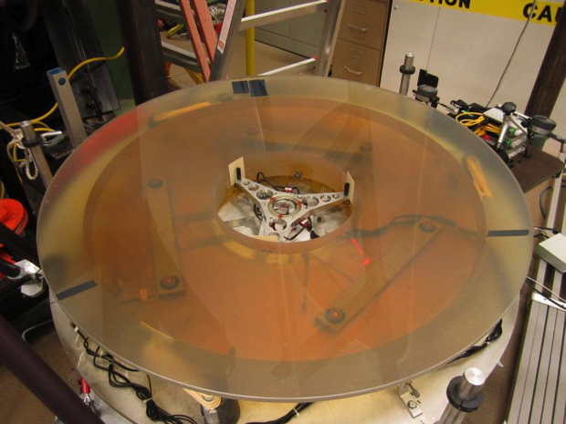
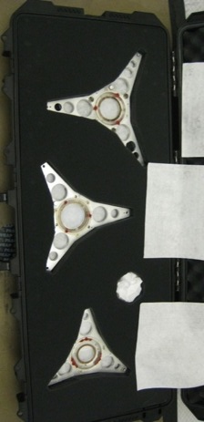
CRT drift issues
M3
M2
M2
M4
M5

Slide 7
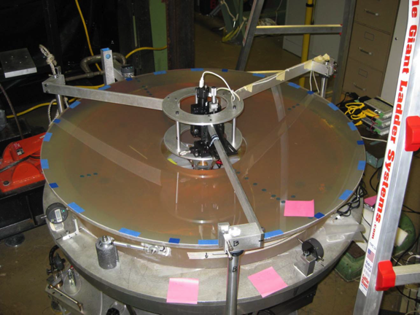
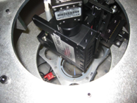
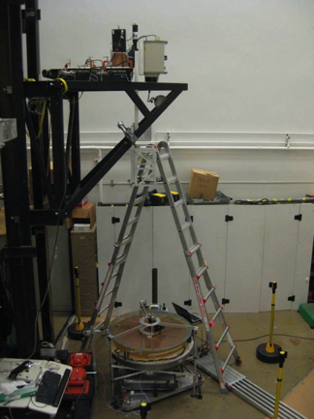
CRT Drift issue
(1. Mirror optical axis registration)
M3
Each mirror is aligned to the rotation axis of the air bearing.
Tip/tilt/Coma due to mirror centering error is monitored by rotating the mirror.
M3

Slide 8
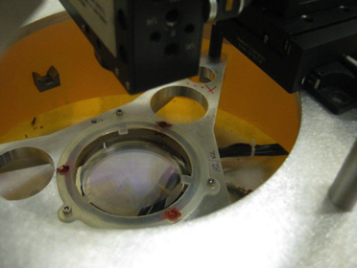
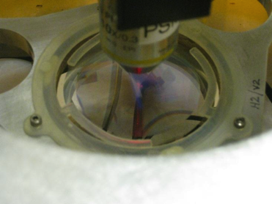
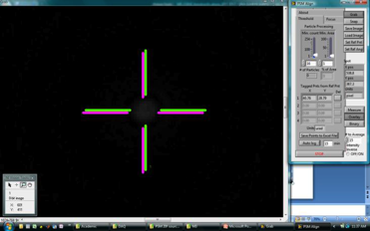
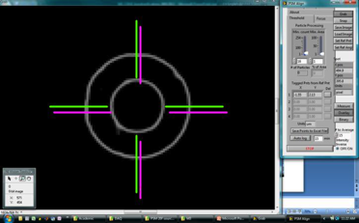
CRT Drift issue
(2 .Registration of CRT to Mirror)
Tip/tilt registration by collimated beam
Decenter registration by x10 imaging
Note: There is a faint spot

Slide 9
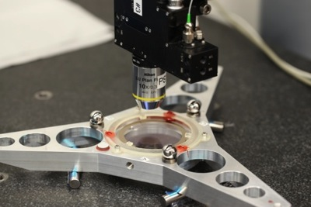
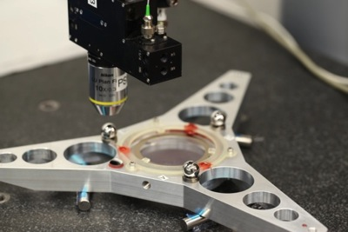
CRT Drift issue
(3 .Registration transfer to SMRs)
Each CRT has three Spherically Mounted Retro-reflectors (SMRs) around the CGH.
The plane of SMRs are registered to the CGH in decenter/spacing/tip/tilt.
  : Measurement accuracy is < 2 micron in decenter and < 1.9arcsec in tip/tilt.
The SMRs form the surrogate of the CGH and facilitate Laser Tracker alignment.
Note: The CGH is yet to be registered in Z to the mirror vertex.

Slide 10
CRT Drift issue
(4 . Vertex spacing registration)
SMR on the mirror surface is measured around the OD and ID.
This provides the location of the mirror vertex.
SMRs on each CRT is registered in Z to this vertex location.
The SMRs on each CRT form the complete surrogate of the mirror.

Slide 11
CRT Drift issue
(Most likely cause & current best knowledge)
UA switched from UV curing epoxy to inadequate adhesive (RTV) in constructing the CRTs (without approval).
This resulted in long- term drift of the CRTs within mechanical cells.
  CRT decenter drift appears small enough.
  CRT Piston is ok since it is done by Laser Tracker and SMRs.
    SMRs have not displaced.
  CRT tip/tilt can not be used and further drift is expected.
CRT | Decenter [μm] |  | Tip/tilt [arcsec] |  | Piston [μm]
 | Old → New | Tol. | Old → New | Tol. | Old → New | Tol.
M2 CGH | 16.2 → 23.8 | +/- 50 | 2.5 → 25.4 | +/- 10 | 7 → 16 | +/- 50
M3 CGH | 3.4 → 13.2 | +/- 50 | 7.5 → 27.3 | +/- 10 | 8 → 16 | +/- 50
M4 CGH | 3.9 → 11.5 | +/- 20 | 1.6 (on-going) | +/- 5 | 7 (no change) | +/- 10
M5 CGH | 7.3 → 9.1 | +/- 50 | 0.6 → 11.7 | +/- 10 | 4 → 9.7 | +/- 10

Slide 12
New alignment plan

Slide 13
New alignment plan
(Summary)
New M4 reference registered to M4 axis in tip/tilt/decenter.
  M4 becomes the decenter / tip / tilt / spacing reference as in the original alignment plan.
All mirrors aligned to M4.
  Decenter done by Alignment Telescope (AT) looking at the CRT centers.
  Spacing done by LT and SMRs.
  Tip/tilt done by LT and SMRs (this will bring the tip/tilt close to the nominal).
Use M4-M5 and M2-M3 CGH tests as the alignment tools
  Adjust M2/3/5 tip/tilt for optimal wavefront of each pair.
Use Conjugate test for M4-M5 alignment verification.
Use System CGH test for the full system alignment verification (3/27/2014)
  UA is developing a back-up system verification test

Slide 14
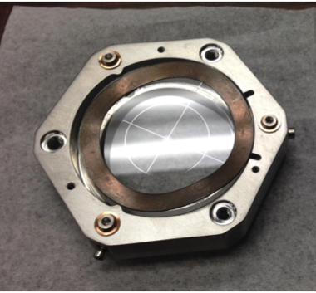
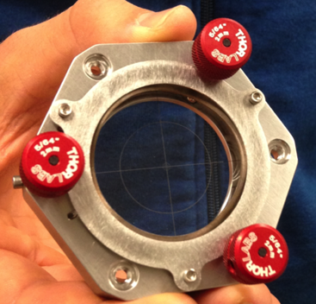
New alignment plan
(Registration of new M4 reference to M4 axis)
New M4 tip/tilt/decenter reference
  Mounted to the same Kinematic mounts as used for M4 CRT.
  Fabrication / assembly done.
  Being registered to M4 axis at this moment.

Slide 15
New alignment plan
(Registration of new M4 reference to M4 axis)
Registration procedure
  Custom alignment telescope registered to M4 optical axis.
    This is done on a 5-DOF stage (i.e. x,y,tip,tilt,rho).
    Existing M4 CRTs are independently verified to be good in decenter.
    Two non-contact probes capture tip / tilt of the alignment telescope w.r.t. M4 surface on rotation.
  New reference is mounted on the back of M4.
  On rotation, the alignment telescope first probes tip / tilt of the new reference.
  New reference is adjusted in tip/tilt accordingly.
  New reference has cross-hair + concentric ring patterns that are going to be used as the decenter registration feature.

Slide 16
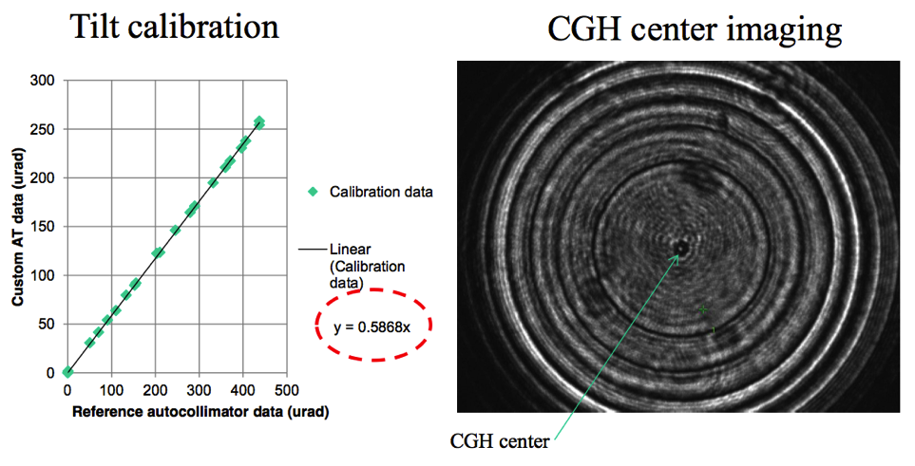
New alignment plan
(Registration of new M4 reference to M4 axis)

Slide 17
New alignment plan
(Registration of new M4 reference to M4 axis)
CRT & New reference
goes on the back of M4
through this cylinder.
M4 + Head-ring
M4 Pier mount
Custom alignment telescope
Rotary air-bearing
X-Y translation stage
Tip/tilt stage

Slide 18
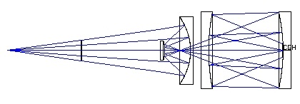
New alignment plan
(CGH alignment tests)
M2/M3 CGH alignment test
M4/M5 CGH alignment test
Interferometer
Interferometer
System verification test
Interferometer

Slide 19
New alignment plan
(Analysis and performance estimation)
UA conducted extensive analysis of the predicted performance of the WFC over the past 2 months.
  Monte-Carlo simulations for M4-M5 and M2-M3 CGH tests.
  Monte-Carlo simulations for System CGH tests based on the MC realizations of two pairs.
Results.
  All performance requirements can be met.
  The wavefront compensation scheme is not expected to result in misalignment-driven field-dependent aberrations.

Slide 20
New alignment plan challenges
The alignment plan requires:
  Highly sensitive measurements ( ~ a few microns, ~ a few 10 nm).
  Highly precise adjustment of the mirrors ( ~ a few microns).
UA has the adequate collection of good metrology equipment and highly skilled opticians and a brilliant graduate student.
UA’s Jeff Kingsley and Chang Jin Oh and Hanshin Lee updated the schedule and new alignment plan using the best and most realistic information available.
UA is committed to put their best effort to complete the alignment in time.
We do think the new plan is solid and do our best to stay on schedule.
→ We know only partially the technical landscape of the alignment.
  → UA’s history indicates that we should expect delay in UA’s alignment plan.

Slide 21
Issue 3
M4 coating degradation

Slide 22
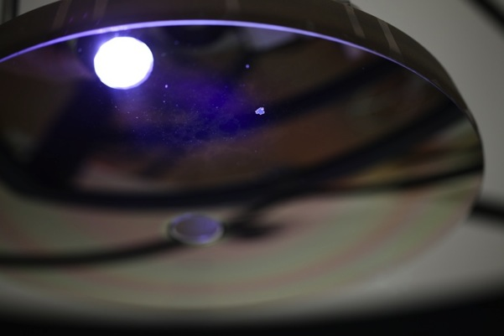
M4 coating degradation
M4 under super-bright LED flash light
A: Locally peeled-off dielectric layer surrounded by complete peel-off
B: Bluish mottling effect underneath the coating
A
B
During inspection on 12/4, both A & B showed more brown color.
→ Indication of Ag-layer being oxidized.

Slide 23
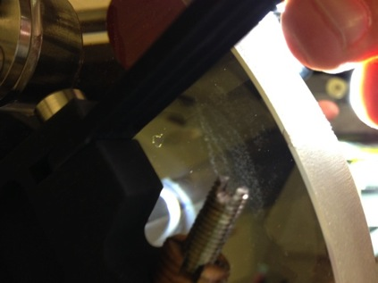
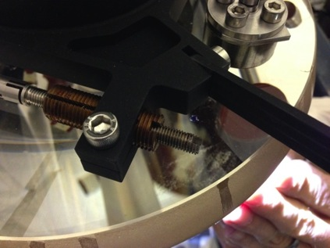
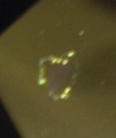
M4 coating degradation
M4 under LED illumination
Light passing through the boundary of the defect

Slide 24
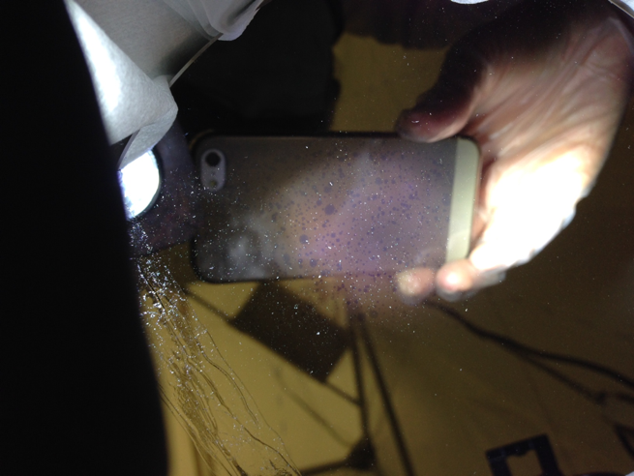
M4 coating degradation
M4 6in witness developed the same mottling effect

Slide 25
M4 coating degradation

Slide 26
M4 coating degradation
(Possible causes & current best knowledge)
Contamination
  STF was flooded during Storm Sandy and coating chambers had water leaks.
  STF coating involves two machines 10 ft apart and transfer from one to the other imposes high likelihood of contamination.
  However, STF claims contamination cannot be the cause.
Spectral measurement indicates the coating is failing.
  Mottling effect indicates contamination as the most likely cause.
  We experienced similar mottling effects in VIRUS collimator mirror coatings.
  Joe Tufts also experienced local peel-off of dielectric layer.
  STF does not have any explanation for this degradation.
  LCOGT coating shows very similar degradation as M4 coating.
STF’s coating is a huge risk for the WFU.

Slide 27
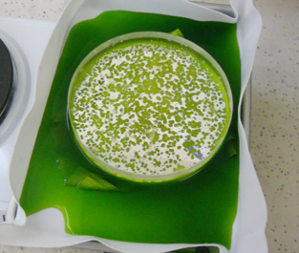
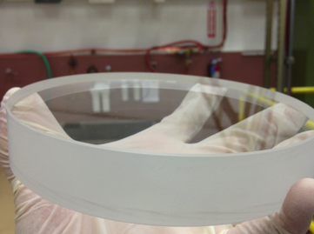
M4 coating degradation
(Stripping M4 coating)
Logan Schoolcraft at HET succeeded in chemically stripping off the coating from the 6in witness in 3 hours.
  We believe M4 coating can also be stripped off as well.
  Logan and Jerry Martin are preparing a stripping fixture for M4.
Stripping in Hydro-Chloride
After stripping

Slide 28
M4 re-coating options
Option | Cost [$k] | Time [wk] | Risk | Merit
JDS Uniphase | 170 | 18 | Long lead-time, higher cost Limited flexibility in scheduling | - Successfully built M2/3/5 coating. - State-of-the-art thin film metrology/control.
ZeCoat | 75 | 4-6 | - No experience with this vendor’s coating. | - David Shiekh developed the adaptation of LL Ag coating (LL coating used in SALT). - Currently running 3 Ag jobs similar to M4. - Drew Phillips (at Lick) is likely to use ZeCoat’s Ag coating for Keck Cosmic Web Imager. - Durability likely to exceed our requirement. - Quick turn-around and more flexibility in scheduling
Quantum Coatings Inc. | > 10 (TBC) | 12 (TBC) | - Bad experience with FSS99. - Reflectance per mirror fails to meet the spec. - Very un-responsive and Drew was told (as of May) that Quantum is getting out of business in metallic coating → Development work less likely. - Limited flexibility in scheduling. | - More recent Ag coating (UV350-Ag) seems durable (1.5yr old on 107’’).
Lick observatory | TBD | TBD | - Reflectance per mirror fails to meet the spec. - No experience with this coating. | - Collaborative development possible. - Produced Ag coating before for internal use.
Aluminum coating | < 10 (TBC) | < 6 (TBC) | - Large throughput hit. | Durable / quick turn-around. Many vendors exist

Slide 29
M4 re-coating options

Slide 30
WFC Schedule & Path forward

Slide 31
WFC key milestones in 2014
M4-M5 CGH alignment : Feb 3
M4-M5 Conjugate verification test : Feb 10
M2-M3 CGH alignment : March 10
System verification test (technical effort in Tucson complete): March 27
WFC delivered without M4 : April 24
M4 delivered to the observatory : May 16 (TBD)
M4 re-assembled / WFC re-aligned / system re-verified : June 13 (TBD)
WFC ready for installation : June 13 (TBD)
We have great confidence in the technical aspects of the new alignment plan and system verification
In spite of our intense focus on the technical and management aspects, we feel that the above schedule has risk based on UAs past performance
  Which, unlike stocks, is probably a good predictor of future performance
We should come up with contingency plans for ensuring good use of the time, should the durations of the UA effort be doubled (6 months instead of 3)
  system verification in June rather than March; installation in September

Slide 32
Path forward on UA alignment & M4 coating
UA alignment.
  We have very close supervision of UA’s effort. Hanshin Lee visits UA every two weeks. Gary Hill is visiting at least every month to reinforce supervision.
  Insisting on close involvement of key personnel (i.e. Jim Burge).
  Hanshin Lee is keeping action item list and reviewing it every week during weekly telecons.
  Herman Kriel is in close contact with Jeff Kingsley on project management issues.
  We have taken on mechanical designs/fabrication for remaining fixturing of CGH tests and others.
M4 Coating.
  Eliminate STF on durability; eliminate enhanced Al on performance
  In parallel, pursue JDSU, ZeCoat, Quantum, Lick obs. to refine cost / schedule / performance estimates.
  Funding situation may dictate path, but we aim to choose the most durable and best performing coating that we can afford.
  Schedule is extremely important.

